Slide 1
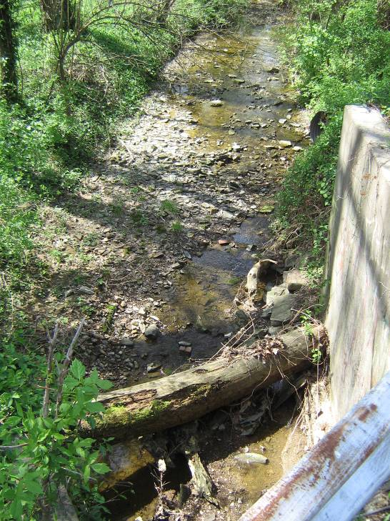
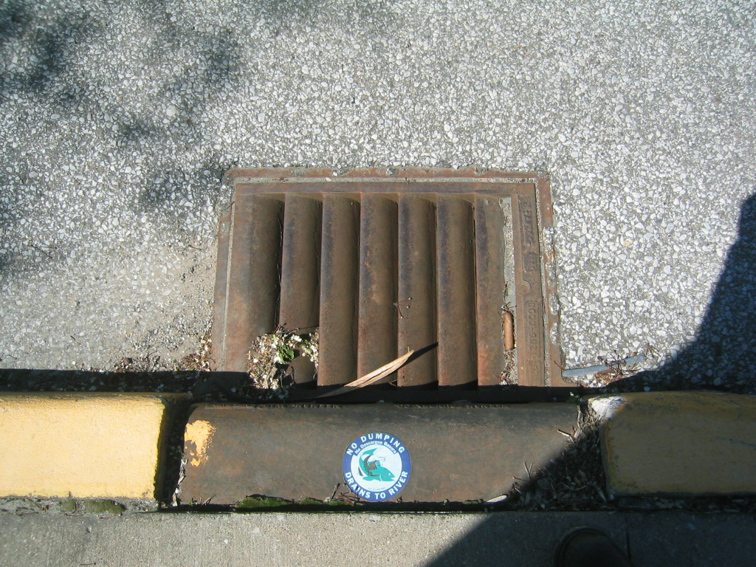

Southern Indiana Stormwater Advisory Committee
Stormwater Pollution Prevention Municipal Employee Training

Slide 2

Outline
General Facility Operations & Maintenance
Vehicle and Equipment Fueling
Spill Response
Vehicle Maintenance, Repair and Cleaning
Maintenance and Repair Projects in the Field
Street Sweeping
Leaf and Woody Debris Collections
Snow Plowing and Road De-icing
Illicit Discharge Detection and Elimination

Slide 3
Introduction to Stormwater Quality
Goal of these training materials:
  Help train you to minimize pollution from entering creeks, streams, rivers, lakes
  Help make your job easier
  Maintain compliance with state and federal requirements
Every employee is responsible for protecting our natural resources

Slide 4

Why Does It Matter?
It’s the Law – Clean Water Act (1972)
Community must comply with a federal pollution program
  Major penalties for noncompliance
  Fines, imprisonment
  Rules are always changing
It benefits our community

Slide 5
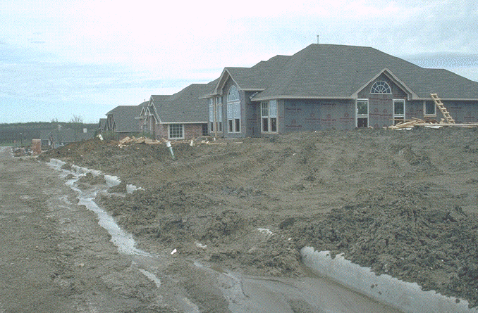
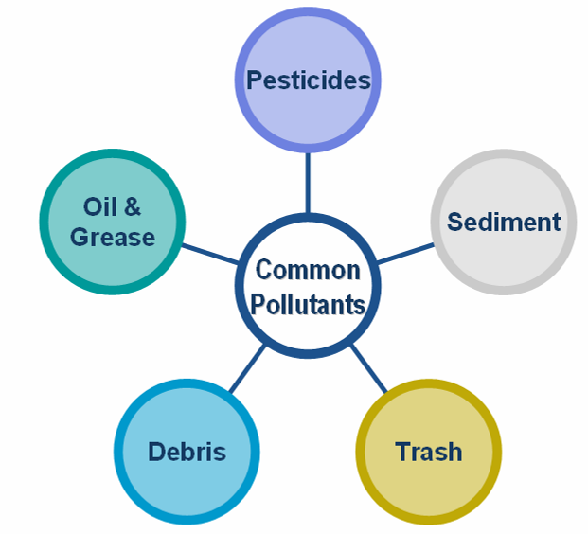
Things You Should Know
Everything you do has an impact on the world around you
  Oils, chemicals, pesticides, salt, fuel, soaps, etc
  Sediment is a pollutant too!

Slide 6

Your Resources
These training materials
Material Safety Data Sheets (MSDS)
  Also Safety Data Sheets (SDS)
The facility’s Stormwater Municipal Operations Plan (SMOP)
Your supervisor
If something doesn’t look or seem right, it probably isn’t, so don’t be afraid to speak up!

Slide 7
Terms You Should Know
Pollutant – Anything in water or on the ground that can harm plants, animals, and the environment
Erosion – Wearing away of land by water or wind
Sediment – Solid material that is transported by water, ice or wind
Sediment is a pollutant!

Slide 8
Remember….
Inaction can lead to water quality problems and noncompliance/fines/penalties
Lead by example
Anything left on the ground will likely get washed to our creeks, rivers and lakes
If you wouldn’t swim in it or drink it, keep it out of the storm system

Slide 9
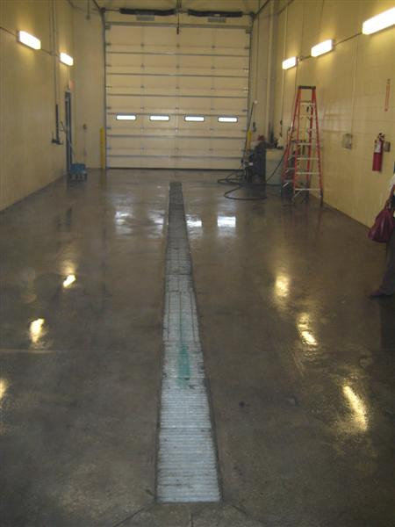
1.1 General Facility Operations & Maintenance
Confine work to designated space
Keep workspaces clean & organized
Know where spill kits are located
Check equipment regularly for leaks – EVERY MORNING
Leaking equipment should be stored inside, with a pan to catch drips
Sweep parking lot regularly and before each rain event
If you don’t know, ask your supervisor

Slide 10
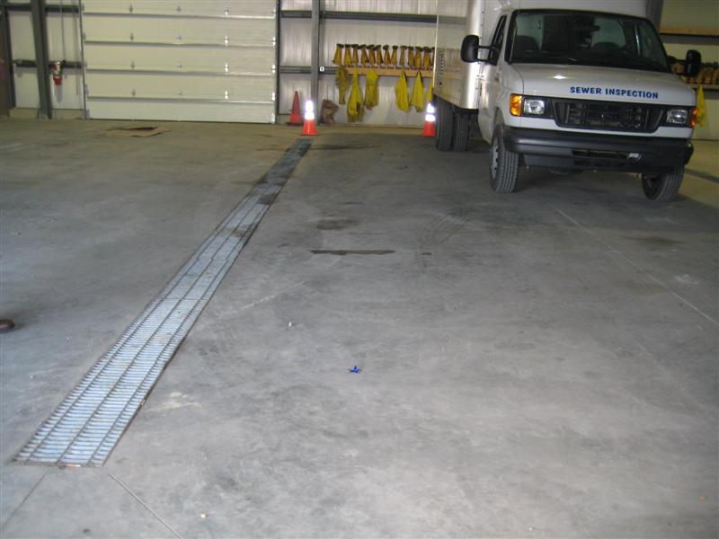
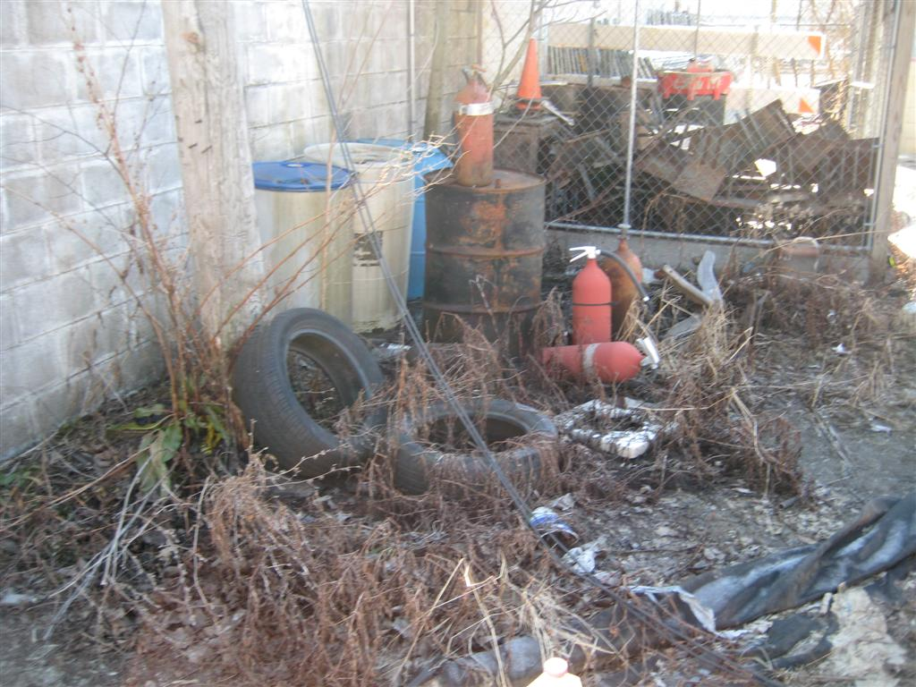
1.1 General Facility Operations & Maintenance
Do
Don’t

Slide 11
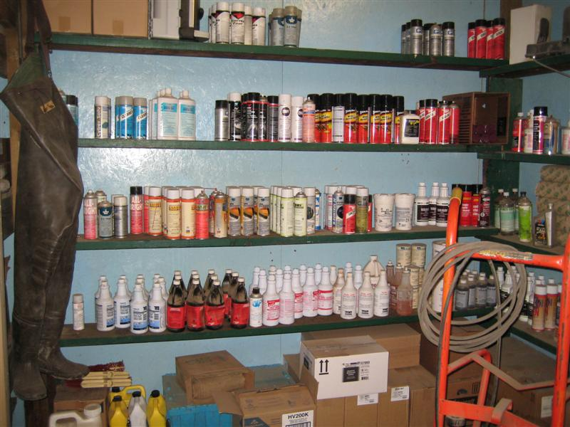
1.2 Material Storage
Store material in properly
labeled containers
Materials should be
stored indoors
Similar materials should
be stored together
Dispose of materials that
are no longer used
Large quantities of liquid
stored with secondary containment
Make sure everything “has a place”
If unsure, follow the MSDS for storage / handling / disposal instructions (Material Safety Data Sheet)

Slide 12
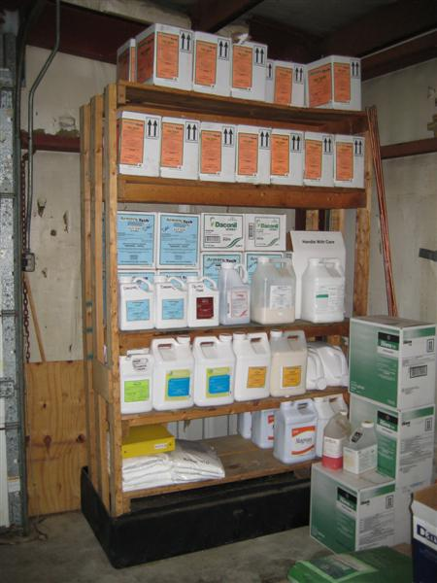
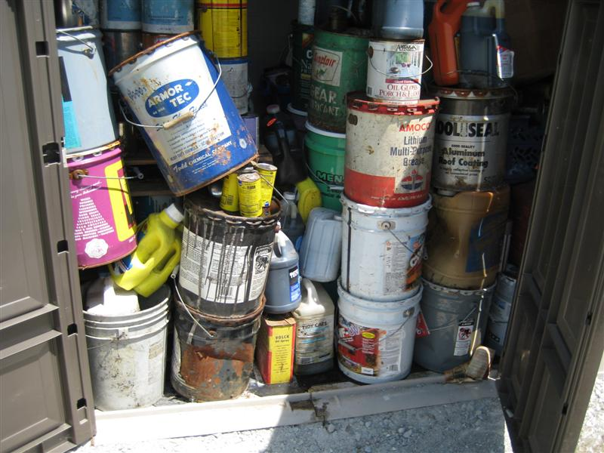
1.2 Material Storage
Do
Don’t

Slide 13
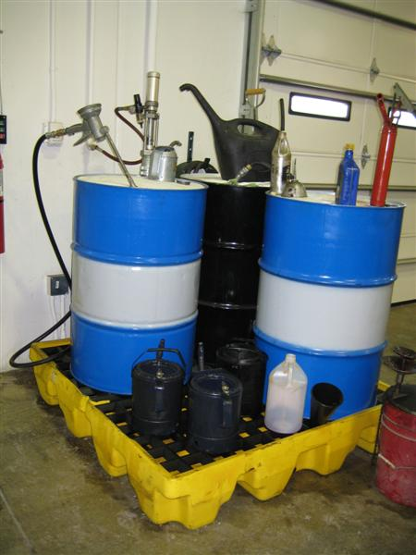
1.3 Bulk Material Storage
Bags of fertilizers and other bulk materials should be stored on pallets, indoors, and away from weather, floor drains, and not in buildings that could flood
Bulk liquids (55 gal drums, etc.) should be stored indoors on spill pallets
Properly dispose of empty containers promptly
Label all supplies and materials

Slide 14
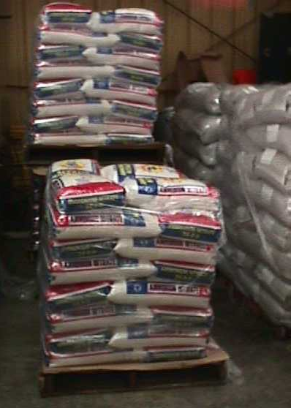
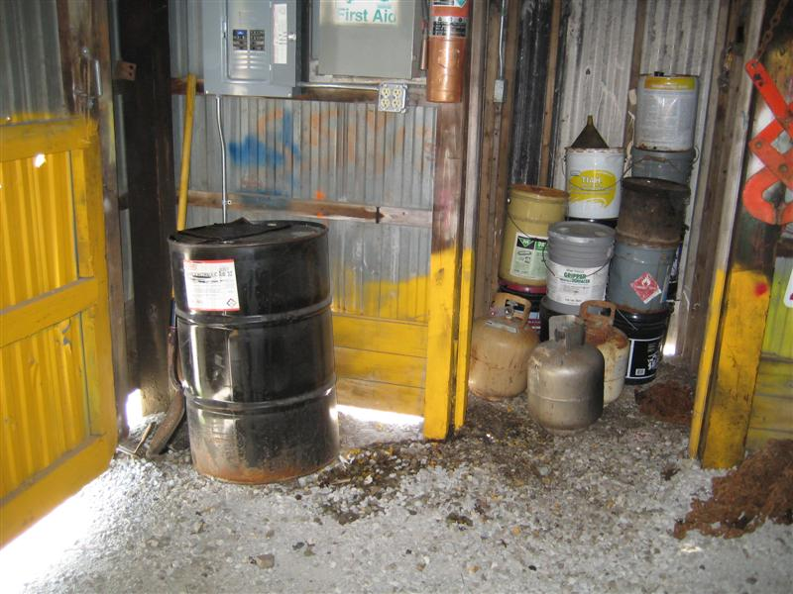
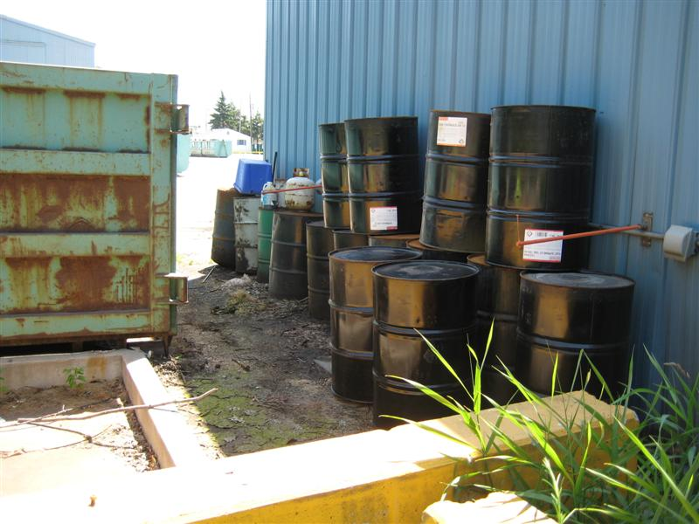
1.3 Bulk Material Storage
Do
Don’t

Slide 15
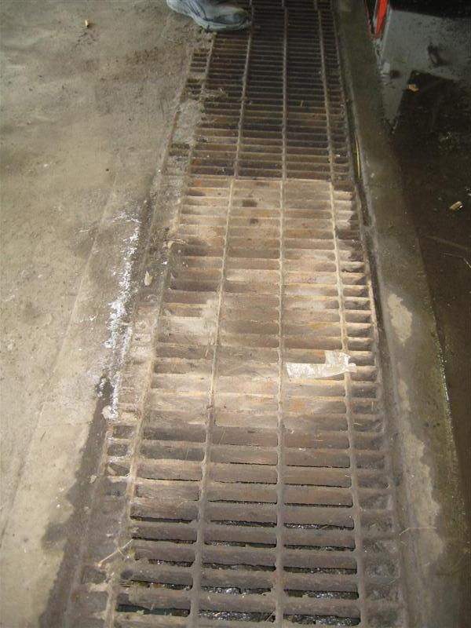
1.4 Floor Drains
Do not dispose of used oil, antifreeze, paint, etc in floor drains
Floor drains should be connected to the sanitary system – know where it goes!
Floor drains should only be used to dispose of wash water
Drains should have a grit collector and an oil/water separator
Floor drains should be cleaned out regularly
If large spill enters drain, try to stop it; notify wastewater

Slide 16
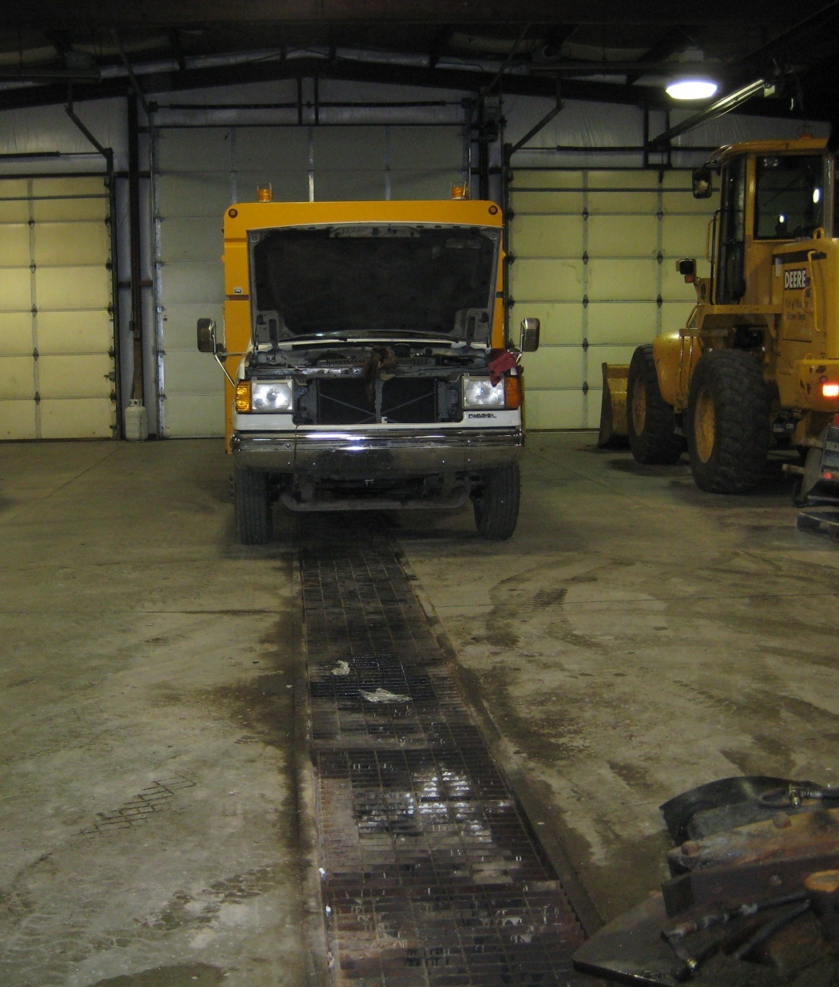
1.4 Floor Drains
Do
Don’t

Slide 17
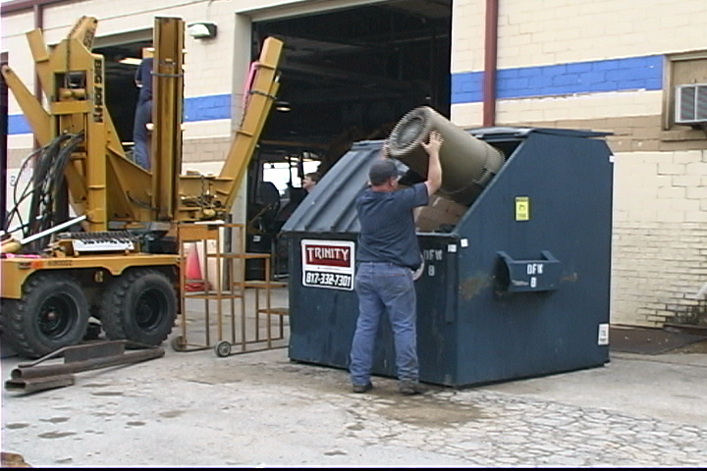
1.5 Waste Disposal—General
Store wastes in designated locations under cover
Recycle as much as possible (aluminum, cardboard, steel, etc.) in separate containers
Keep dumpster lids closed
Make sure all using dumpsters understand what does/doesn’t belong
If you don’t know, ask your supervisor

Slide 18
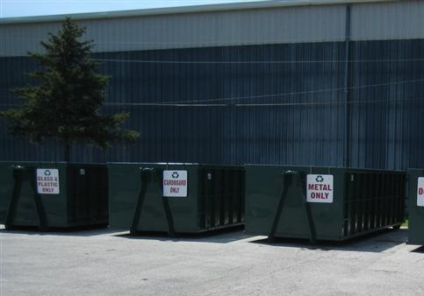
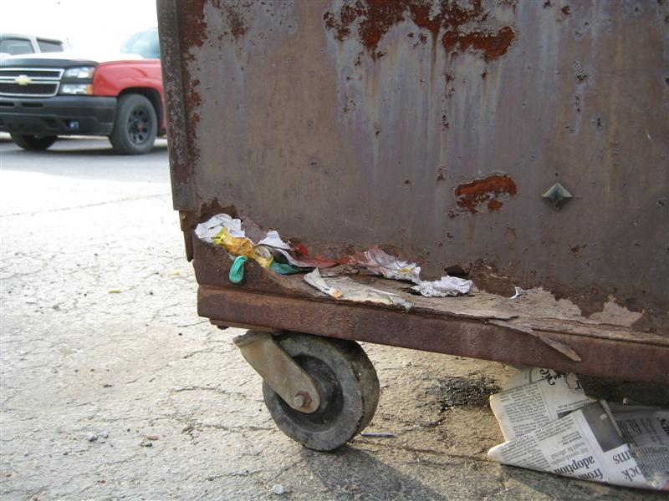
1.5 Waste Disposal—General
Do
Don’t

Slide 19
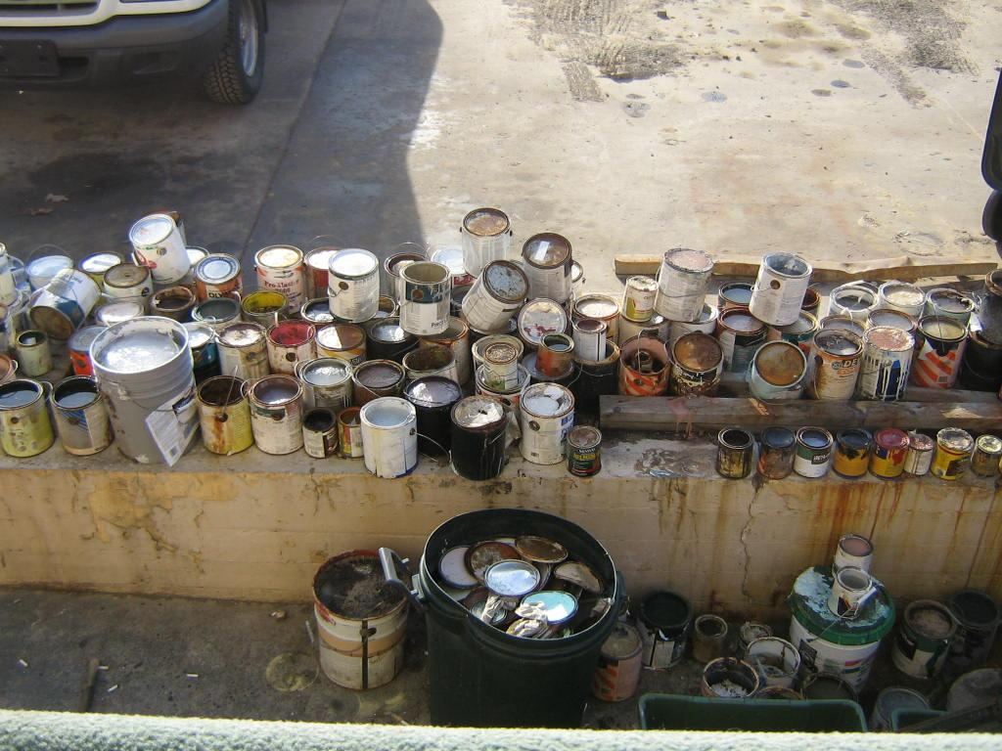
1.6 Waste Disposal—Specific
Set up special containers to collect used fluids, antifreeze, oil, transmission fluid, hydraulic fluid, batteries, and other materials
Periodic removal of materials should be handled by a qualified vendor
Waste tires should be stored under cover and disposed of before accumulating large quantities

Slide 20
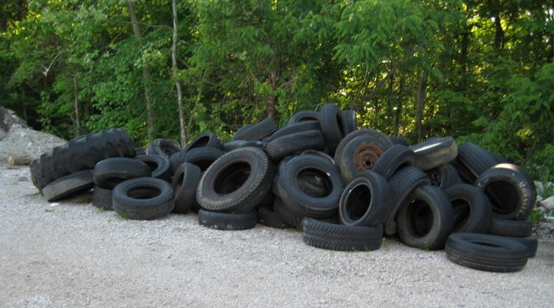
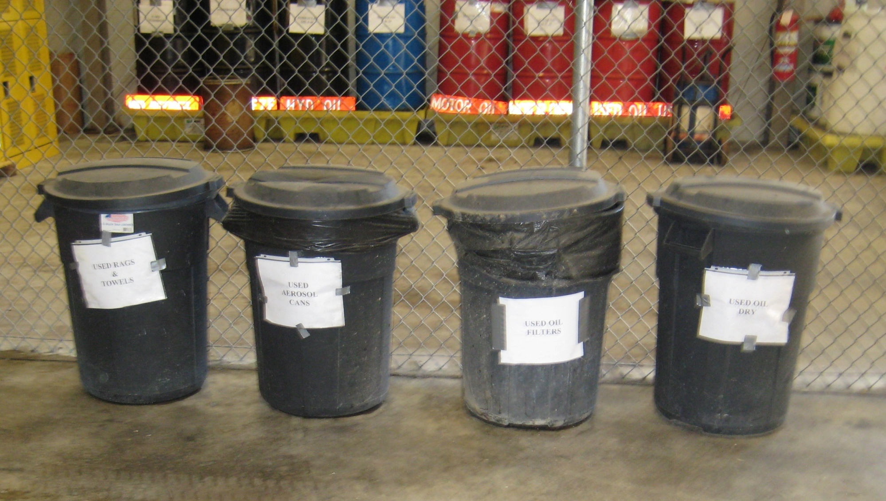
1.6 Waste Disposal—Specific
Don’t
Do

Slide 21
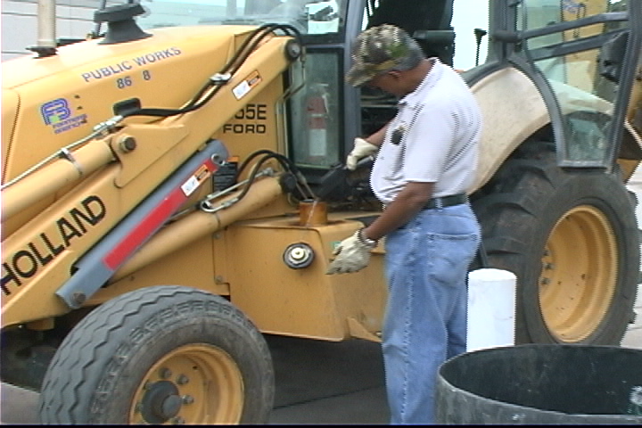
2.1 General Fueling Procedures
Never leave a pump unattended while refueling
Do not top off fuel tanks
Only dispense fuel in designated containers and periodically inspect containers for leaks
Trash can, fire extinguisher and spill kit should be located near fuel pumps
Know location of emergency shut-off

Slide 22
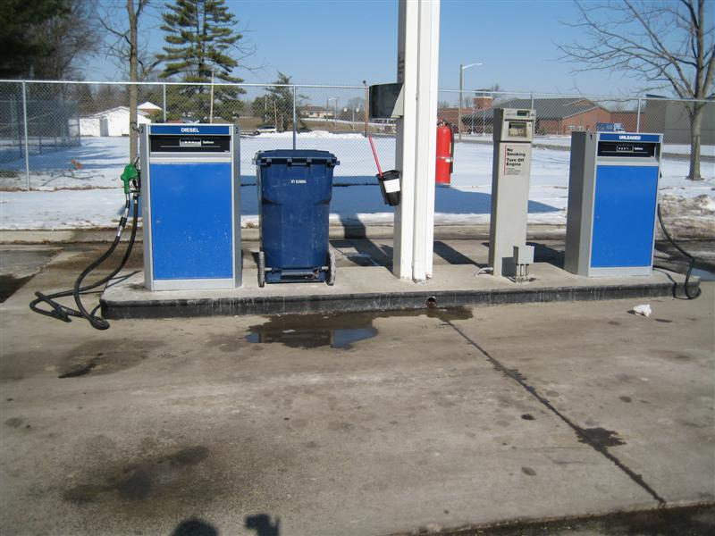
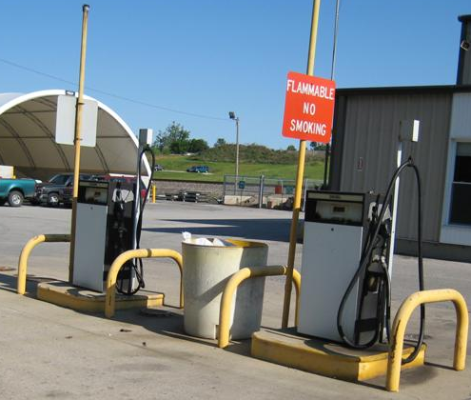
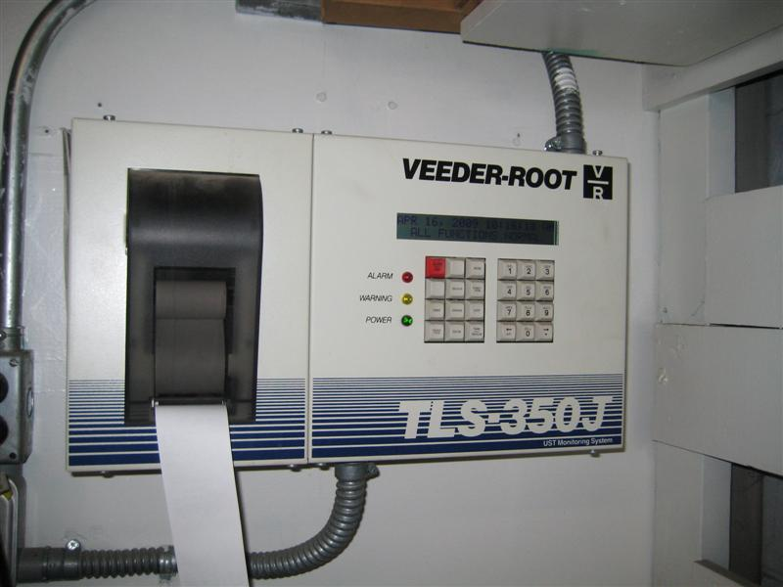
2.1 General Fueling Procedures
Do
Don’t

Slide 23
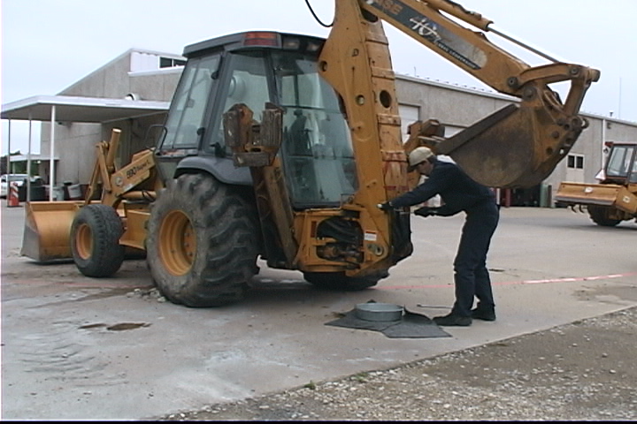
2.2 Fuel Spill Procedures
Know where your emergency shut-off is
Use spill kit for small spills
Large spills should be contained and immediately reported
to supervisor
Protect nearby storm drains with absorbent materials or barriers
Regularly inspect hoses/connections/fuel filter for leaks and replace as needed
Inspect and refill spill response kits monthly

Slide 24
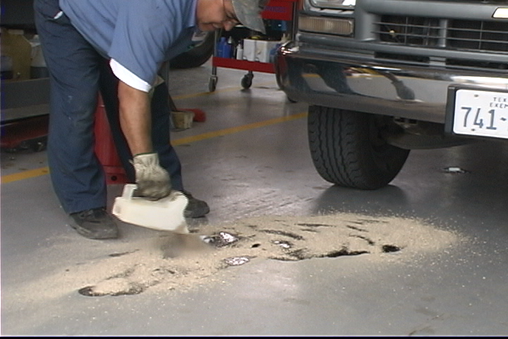
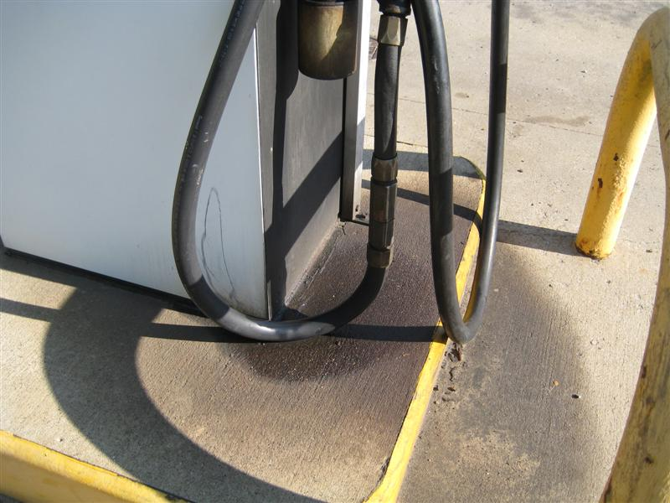
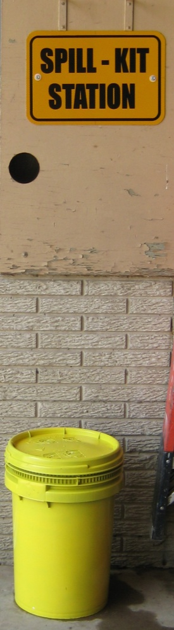
2.2 Fuel Spill Procedures
Do
Don’t

Slide 25
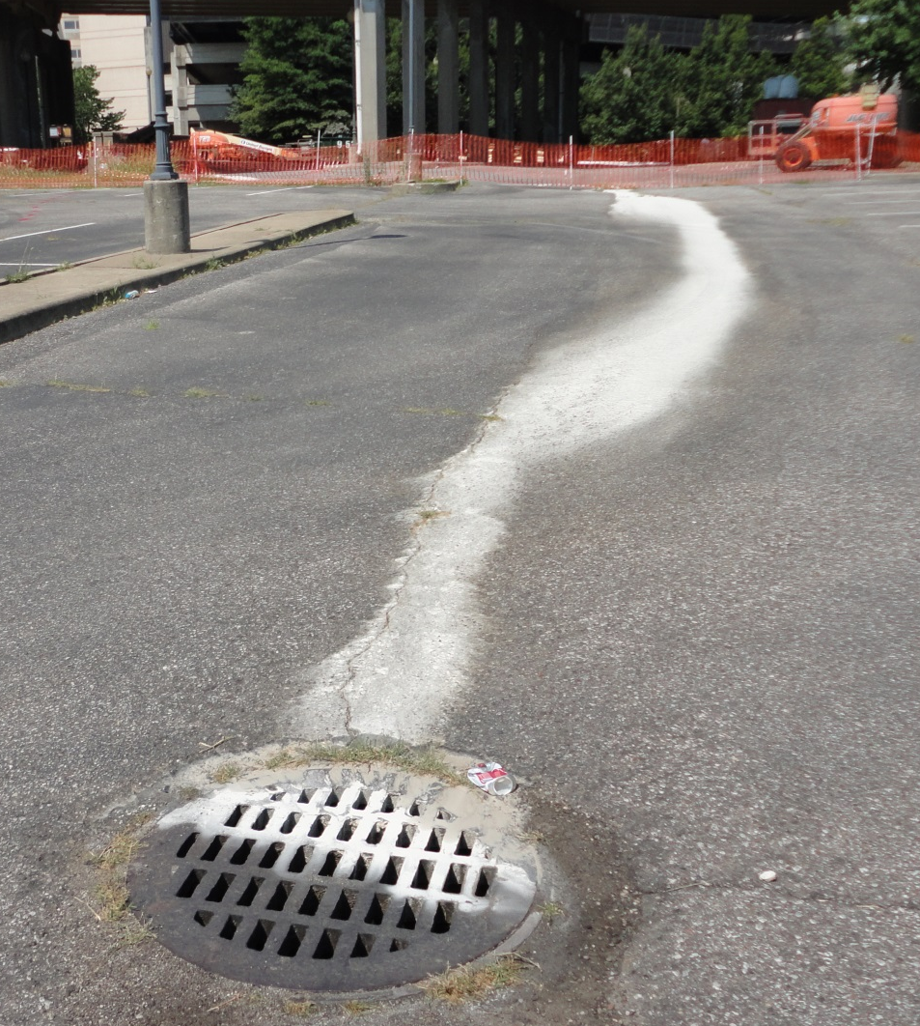
3.1 Small Spill Procedures
Attend to spills immediately
Use absorbent /
adsorbent material
Sweep up after about 20
minutes
Dispose of collected
material properly
Don’t hose spills into
storm drains or outside
areas
For hazardous liquid spills, refer to MSDS for clean-up procedures
Notify supervisor if spills reach storm drain or leave site

Slide 26
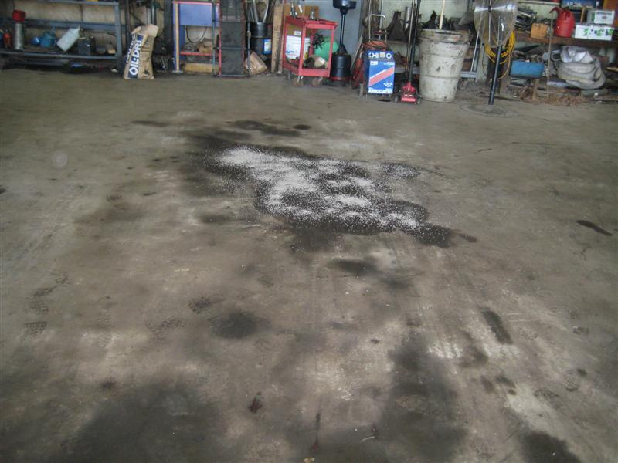
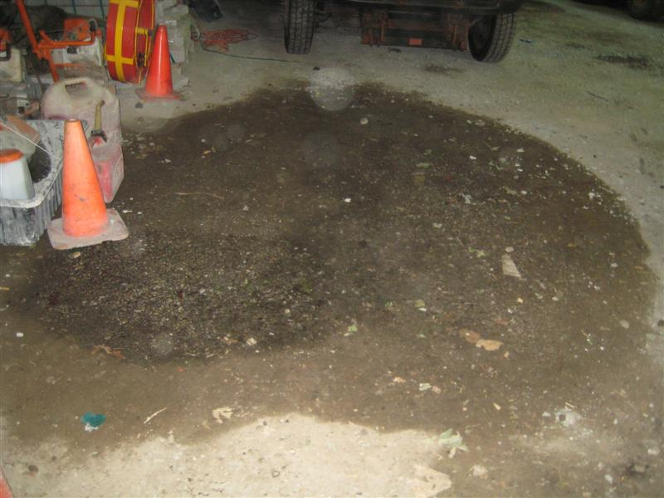
3.1 Small Spill Procedures
Do
Don’t

Slide 27
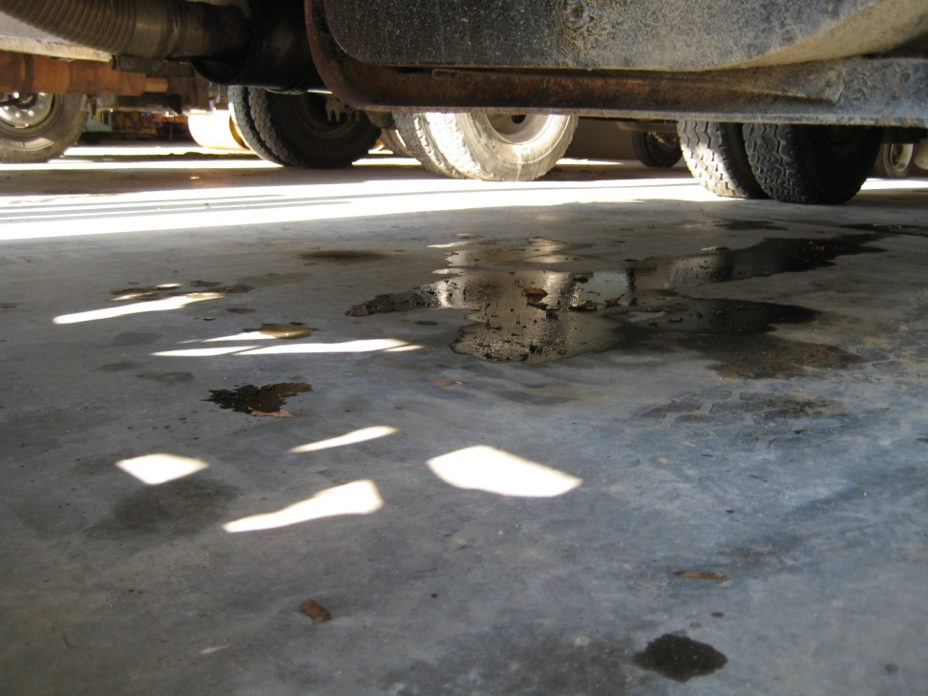
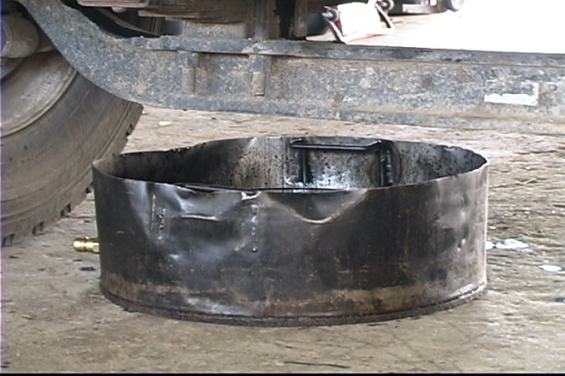
3.2 Leaking Equipment and Vehicles
Use drip pans for leaking equipment
Have equipment immediately repaired
Leaking vehicles should be stored inside
To help detect leak, inspect equipment daily before each use

Slide 28
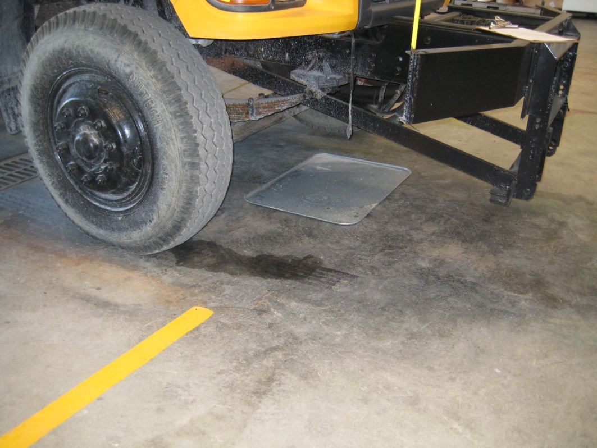
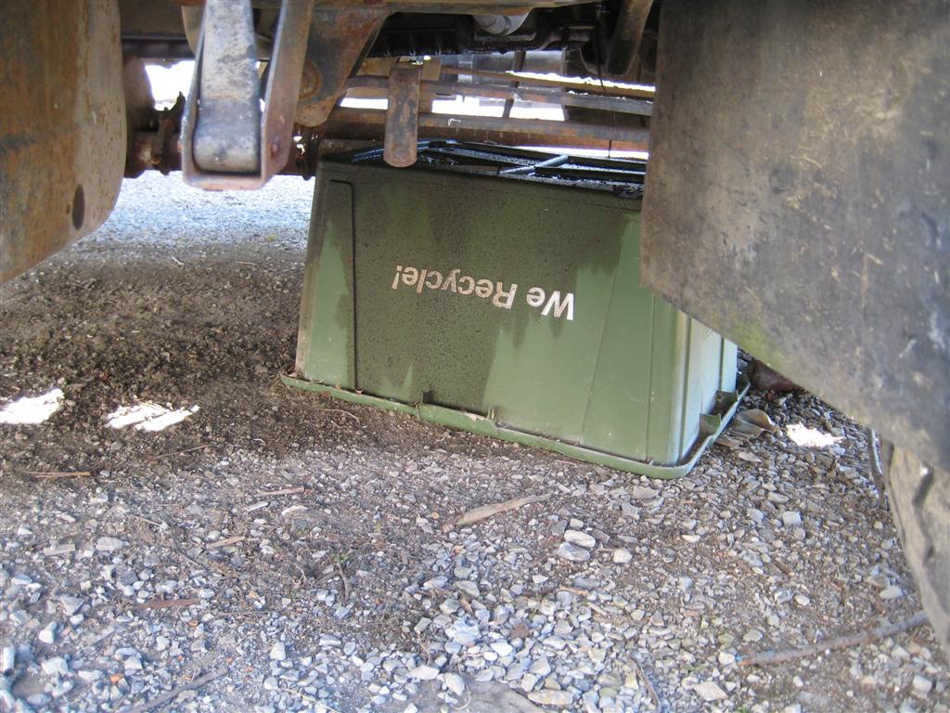
3.2 Leaking Equipment and Vehicles
Do
Don’t

Slide 29
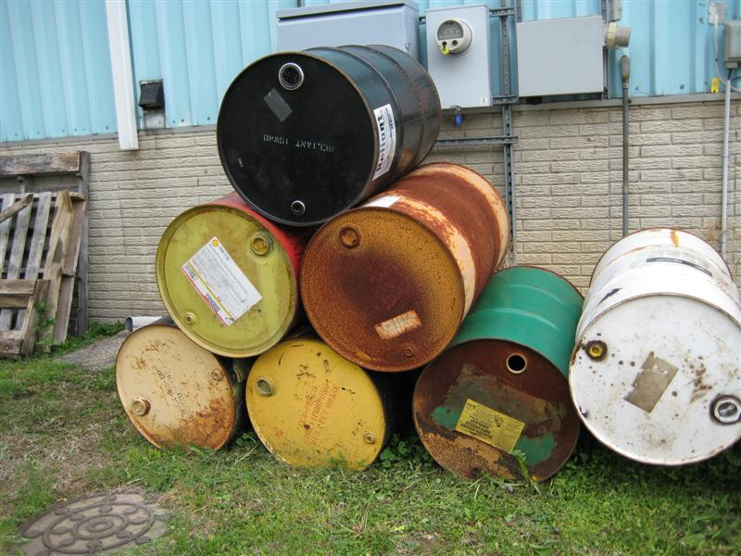
3.3 Large Spill Procedures
Immediately notify facility
manager
Safely stop the release if
possible
Do NOT hose the spill into a storm drain, drainage way, or stream
Refer to MSDS for procedures and safety equipment needed
Report all releases larger than a gallon to your supervisor immediately
Document spill quantities in facility’s Stormwater Municipal Operations Plan

Slide 30

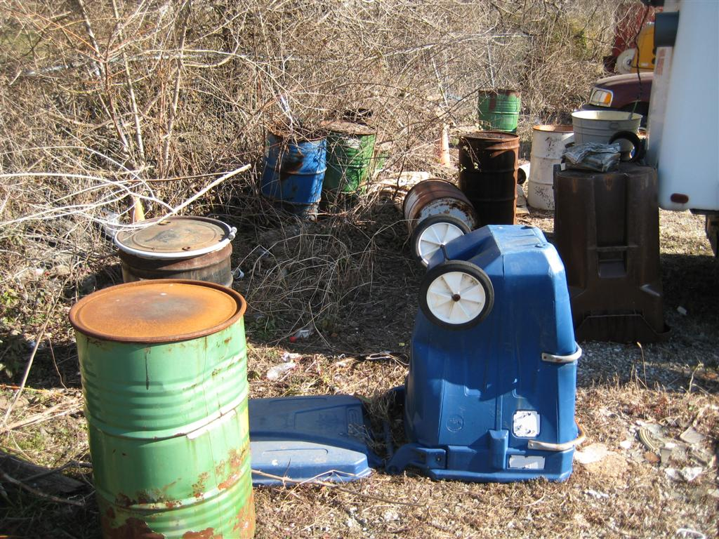
3.3 Large Spill Procedures
Do
Don’t

Slide 31
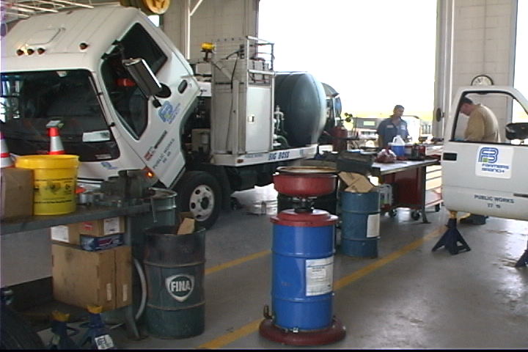
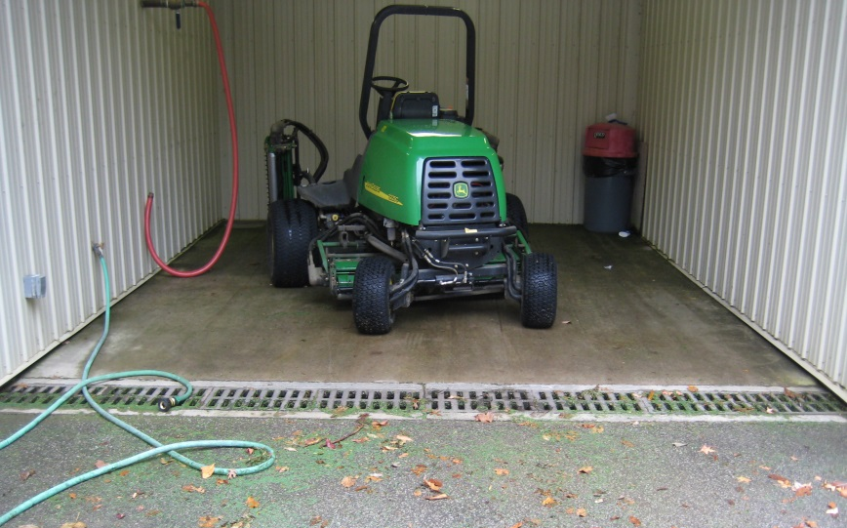
4.1 Maintenance and Repair Procedures
All maintenance should take place in designated garage
Regularly inspect equipment for problems
Transfer drip pans to designated storage containers as soon as possible
Store used oil, antifreeze, brake pads, batteries, etc. separately until recycled or properly thrown away

Slide 32
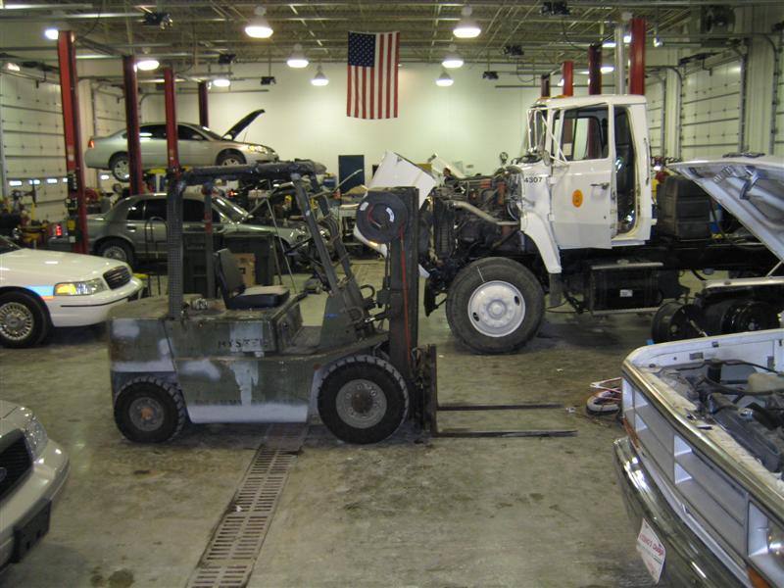
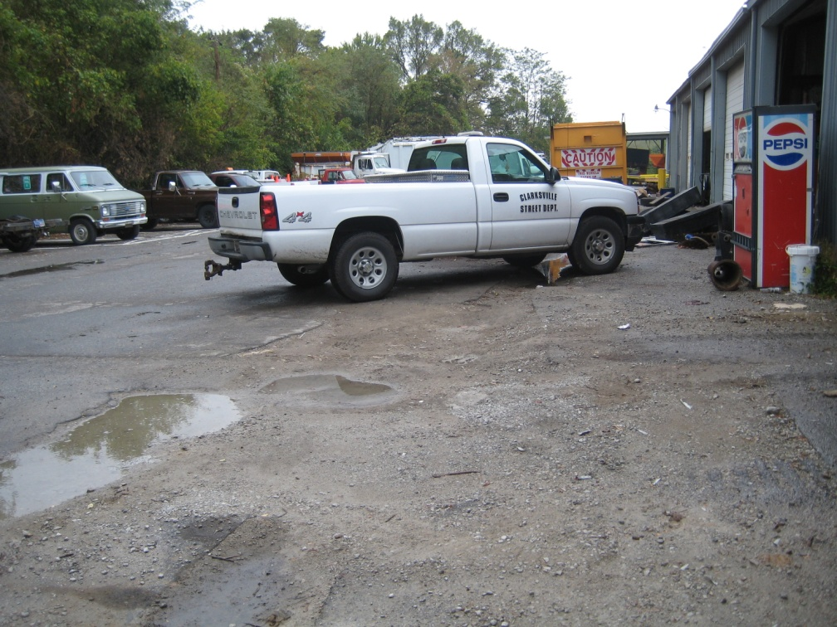
4.1 Maintenance and Repair Procedures
Do
Don’t

Slide 33
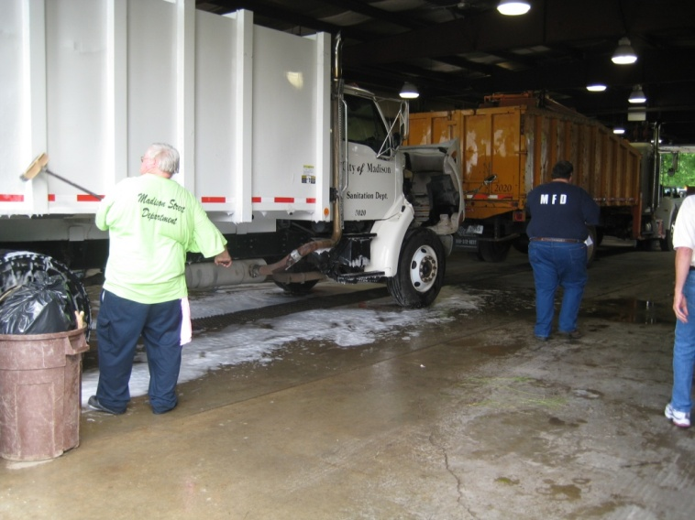
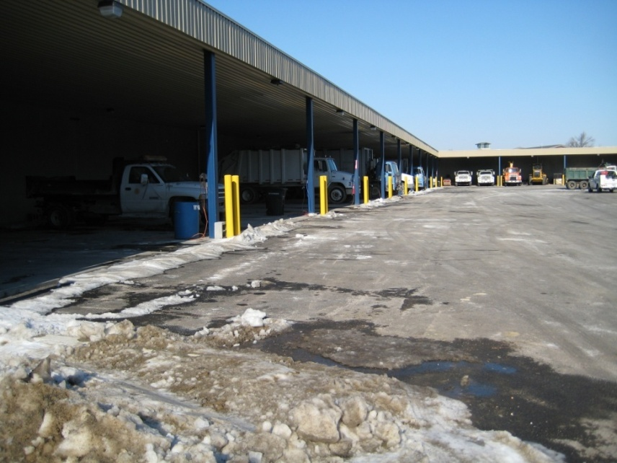
4.2 Vehicle Cleaning & Storage Procedures
Excessively dirty vehicles should be stored under cover until washed
Wash vehicles in designated facility that drains to sanitary sewer – NOT outdoors or over storm drains
Damaged, leaking,
or idle vehicles and
equipment should
be stored under
cover

Slide 34
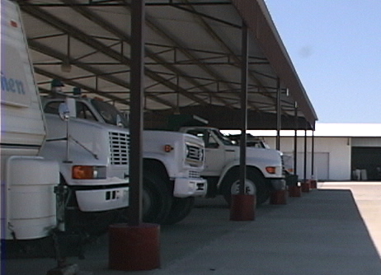
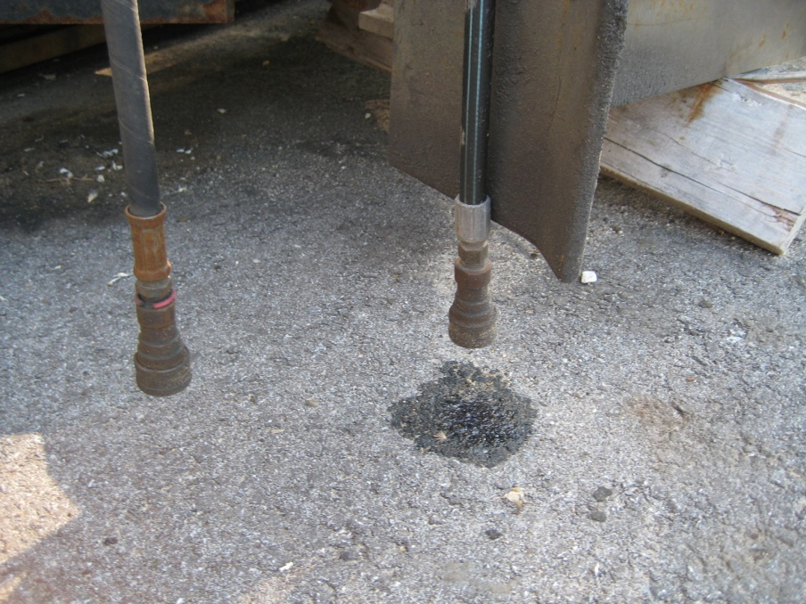
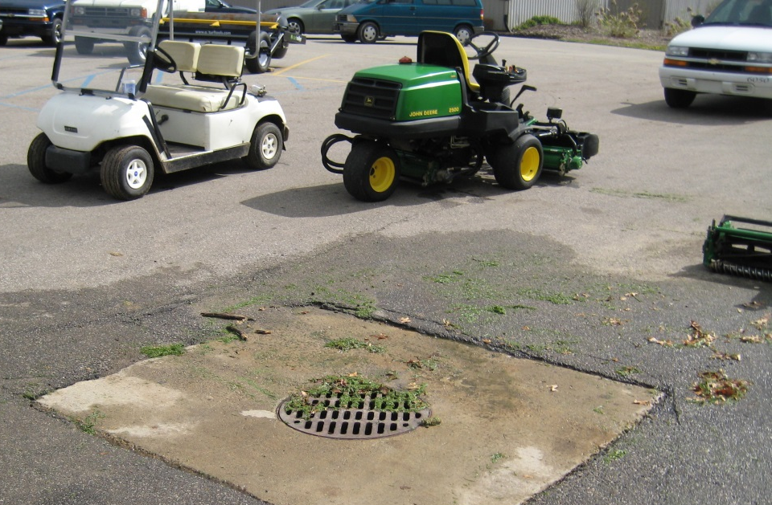
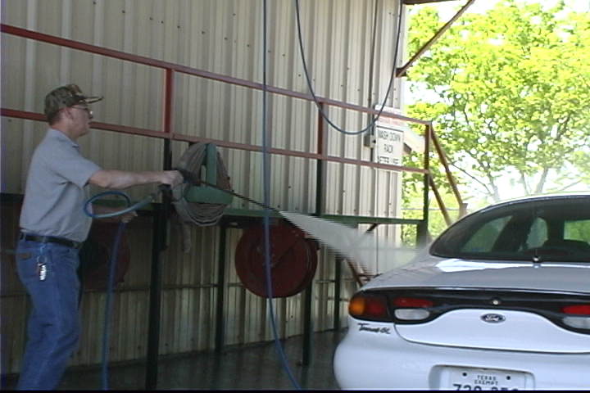
4.2 Vehicle Cleaning & Storage Procedures
Do
Don’t

Slide 35
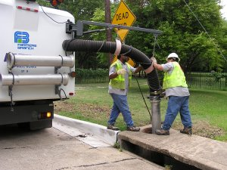

5.1 Catch Basin Maintenance
Clean debris from catch basins to improve drainage and reduce stormwater pollution
Each crew will have a spill response kit on at least one vehicle while in the field
If dewatering, pump to sanitary system or grassy area
Solve small problems before they become big problems

Slide 36


5.1 Catch Basin Maintenance
Do
Don’t

Slide 37

5.2 Minimizing Erosion and Sediment Releases at Project Sites
Minimize the disturbed area when performing activities
Don’t place sediment in the stream channel or floodplain
Don’t remove stream bank vegetation
Immediately seed and mulch disturbed area
Follow up to ensure vegetation is established

Slide 38


5.2 Minimizing Erosion and Sediment Releases at Project Sites
Do
Don’t

Slide 39

5.3 Pumping & Dewatering Operations
When removing water from a
trench or low area:
Discharge water to sediment
containment bag or behind silt
fences
Do NOT discharge directly to a
creek or water body
Make sure hose discharge does
not cause scouring / erosion
Discharge water to a grassy area
Do not pump contaminated water (i.e. Oily waters, sanitary overflows / spills, etc) to anything other than the wastewater treatment system or specialized containment vehicle

Slide 40



5.3 Pumping & Dewatering Operations
Do
Don’t

Slide 41

5.4 Outlet Protection & Scour Prevention
Stabilize and repair erosion and scouring from pipe discharges
by “armoring” outlets with:
Turf reinforcement mats,
HDPE permanent
transition mats (PTMs),
Erosion control blankets,
Vegetation,
Riprap,
Other.
* Spread flow out to minimize erosion.
* Minimize immediate changes in direction.

Slide 42


5.4 Outlet Protection & Scour Prevention
Do
Don’t:
Don’t Ignore Problems!

Slide 43

6.1 Street Sweeping Procedures
Inspect equipment and
maintain prior to use
Sweep before rain is
forecasted, when possible
Identify roads requiring
more frequent sweeping
(heavier traveled roads)
Know how and where to
dispose of collections –
typically in standard solid waste
For wet-sweeping operations, dewater to sanitary system or on grassy area away from water bodies

Slide 44


6.1 Street Sweeping Procedures
Do
Don’t
Don’t Dispose Collections in Compost

Slide 45

6.2 Disposal of Street Sweeping and Litter / Waste Collections
Collections should be disposed of in designated areas
If wash water is collected, discharge liquid to the sanitary sewer
Dry roadside litter and street sweepings sufficiently and place in solid waste dumpsters

Slide 46


6.2 Disposal of Street Sweeping and Litter / Waste Collections
Do
Don’t

Slide 47

7.1 Leaf and Woody Debris Collection Procedures
Inspect leaf machine prior
to use; maintain as needed
Plan the route to optimize
useful road time
Use required safety
equipment
Know proper disposal
location and procedures
Rake leaves to loosen them
and pick up with leaf machine
Collect leaves before rain event to minimize amount washed into drainage system;
  Flooding problems and water quality problems

Slide 48




7.1 Leaf and Woody Debris Collection Procedures
Do
Don’t

Slide 49


7.2 Disposal of Leaf and Woody Material
Dispose of collection at the compost disposal facility or other designated areas

Slide 50


7.2 Disposal of Leaf and Woody Material
Do
Don’t

Slide 51


8.1 Plowing and De-icing Operations
Inspect and maintain equipment for proper operation
Exercise care when connecting / disconnecting hydraulic hoses
Sweep area outside of storage barn after loading / unloading salt
Wash equipment in designated areas
Store unused equipment under cover, when possible

Slide 52


8.1 Plowing and De-icing Operations
Do
Don’t

Slide 53

8.2 Salt Storage and Handling
Move delivered salt into covered storage area immediately
Cover the entrance or the face of the salt pile with tarps to keep it dry
Sweep storage areas clean before and after loading
Load salt trucks on a paved surface

Slide 54



8.2 Salt Storage and Handling
Do
Don’t

Slide 55

8.3 Winter Equipment Cleaning & Storage
Between uses, hose off excess salt accumulations from bed and wheel-wells of vehicle
Store salt boxes, plows, brining equipment under cover when not in use, if possible
Exercise caution when
disconnecting
hydraulic lines to
plows; be ready for spills
and drips from hoses

Slide 56


8.3 Winter Equipment Cleaning & Storage
Do
Don’t

Slide 57


9.1 Illicit Discharge Detection and Elimination
Non-stormwater discharge = Illicit Discharge
IDDE Field Guide Handbook – www.siswac.org
Visual screening and identifications
Enforcement Authority: Illicit Discharge Ordinance

Slide 58

9.2 Procedures for Detecting an Illicit Discharge

Slide 59


9.3 Indicators to Look For
Flow
  Especially during dry-weather
  May indicate cross-contamination with sanitary discharges
Cloudiness
  Turbidity
  Caused by soil erosion, sediment-laden runoff, dredging

Slide 60
Odor
  Strong or unnatural
Odor | General Causes
Musty | Raw or partially treated sewage Livestock waste
Sewage | Sanitary wastewater from cross-connection with the drainage system Septic tank/ failing septic system
Rotten Eggs (sulfide) | Stale sanitary wastewater Meat processing plants/ canneries/ dairies Decomposing organic matter
Gas or Oil | Gas stations Vehicle maintenance operations Illegal disposal Industrial operations: refineries/ manufacturing
Sharp, pungent | Chemicals Pesticides
Rancid, sour | Food processing facilities Dairies
Chlorine | Wastewater treatment plant discharges Swimming pool discharges Local manufacturing / industrial sites
Sweet, fruity | Commercial wash water

Slide 61

Color
  Excessive or unnatural
  Yellow: chemical
  Brown: construction activities
  Green: chemicals, algae, fertilizer
  Gray: sewage, concrete wash-out
  Milky white: paint, lime, concrete, swimming pools
  Red: fabric dyes, meat packing
  Crusty white deposits: salt, brine
Sheen
  Oily surface
  Likely caused by illegal dumping/automotive leak

Slide 62



Floatables
  Unnatural: solids/liquids from industrial or sanitary wastewater, trash, toilet paper, foam
Excessive algae/plant growth (scum)
  Indicates high levels of fertilizer
  Can result in fish kills

Slide 63



Stains/Deposits
  Likely from construction site
  Concrete washout

Slide 64





Report potential illicit discharges to your supervisor!

Slide 65
Conclusion
Resources available to you and your staff
  This presentation
    Municipal Employee Training: Modules 1 thru 9
  Municipal Employee Training Videos (DVD)
  Your facility’s Stormwater Municipal Operations Plan (SMOP)
  Illicit Discharge Detection & Elimination Field Guide
  Stormwater Resource Handbook
    Quick reference fact sheets
  Your Supervisor & Stormwater Coordinator

Slide 66
Conclusion
Your daily activities have a direct impact on the environment
It’s required: State and Federal laws
Educating your staff:
  Provide handouts with examples
  Regular trainings
    One training module per month
    Trainings coincide with routine safety discussion
  Test the staff’s knowledge (written or otherwise)
  Don’t forget seasonal staff and new hires
  As knowledge grows, provide new content
  Encourage your staff to speak up

Slide 67

Thank You for Attending
We all have to do our part to keep our natural resources, environment, and communities clean!

